Slide 1
Ref/ Failure Date : Protus : Pro 6048HT vehicle – 25 Oct, 2024
Complaint : Pro6048HT_Singruali_Errror code is coming of Reductant Pressure Too Low_P20E892
Part’s mileage/cumulative mileage/target : 83,091 Km kms (7622 Hrs )
Vehicle ID : Pro 6048HT vehicle -MC2HCSRC0PE096303_Vehicle ID 8630
Durability test at : Coal application _Singrauli MP
1 | 5 | 25 | 100
Author, Date:Supal singh,28th Oct, 2024
Design Engineer:- Saurav Roy
PICTURE
Part No: ID374268
Part name :- Vehicle Control system
Observation:-
From telematics daily tracking below are the error code appearing
Pro6048HT_Singruali_Error code is coming of
Reductant Pressure Too Low_P20E892
Same issue is observed in below chassis also
MC2HCSRC0PD094477
MC2HCSRC0PE097377
History :
Vehicle is running at Singrauli-Coal Application.
Probable cause:-
To be analyzed
Action taken
Vehicle is under attending with Control team.

Slide 2
PROTUS statement :-
Why/Why | Why/Why -RCA (Fact finding) | Reasons for Problem | Corrective action with relevant document evidence
Why1 | Error code → Reductant Pressure Too Low_P20E892 | Why is the error code coming: Filter Clogging | Filter media changed from 2D to 3D. Filtration area is increased from 10,000mm² to 18,600mm². Vent Plug used inside the air vent pipe to block air entrance.
Why 2 | Filter Clogging→ Scaling on filter surface Insufficient Filtration Area Air aspiration from Air vent Pipe | Scaling on filter surface → Current 2D filter is susceptible to the scaling when subjected to Adulterated Urea Insufficient Filtration Area → Less filtration area leads to early clogging of filter Air aspiration from Air vent Pipe → Air getting sucked in from air vent pipe leading to cavitation in pump
Design issue (Y/N) | Quality issue (Y/N)
Y | N
Process Issue (Y/N) | Others:-(Deviation / Handling)
N | N
Attachment :-
(CAPA/8D/Deviation /Fishbone
Failed Part( Rel lev) | Make -
ID381545 (A) | SSI
Prevent recurrence of the problem at the problem site and across the organization
Document Updation / Related activities | Applicability (Y/N) | In-House /Vendor | Resp | Target Date | Status | Date of Closure
PFMEA/DFMEA | Y |  | Design rep |  | Completed | 25/10/24
PPAP | Y |  |  |  | Completed
Process Flow/AOS | Y |  | ME Rep |  | Completed(BAPL)
SOP Update | Y |  | PMO rep |  | SOP Done | 12/10/24
Process Audit Sheet | Y |  | QA Rep |  | Completed | 12/10/24
Quality / Gate Check Sheet | Y |  |  |  | Completed | 12/10/24
Action in Stores | NA |  |  |  | -
ECO / Drawing | Y |  | Design rep |  | Released | 30/04/24
Resolution in Field |  |  | Q&CS rep |  | -
PR No | ECO No
NA | CA-24-00037180 CA-24-00040613
RCA reviewed By:-
Saurav Roy

Slide 3
Method
Man
Pump Main Filter Clogging
Urea Diesel Misfiling
Urea Warning level too low
Urea Filled using a Diesel / oil Filling Tube: may Lead to P sensor failure.
Air Entrapment bubble formation inside filter
→ Causing Pressure drop
Pump Inlet Connector Clogging
Non ISO22241 grade urea- Cosmetic grade urea
Foreign Particles
Inside Pump
High Cl & S Content in Urea
Tank water cleaning
efficacy
Tank Filling Hygine issue
Low Pressure DTC:
P20E892/P204F93
Connector Damage-
Pre-Commissioning
Level sensor Filter
35 µm 2D Filter
Urea Line QRC O ring Joint – sealing ?
Pressure Line < 10m
Pipe Diameter – Ø6
Pump Inside Child parts Rust or wear or leak
Purging Time-
MDEP & Volvo NA – No Purging,
Insufficient Suction Pressure – 400 hpa
Calcium, Magnesium and Sodium
found in UREA
From Open Source
Suction line sealing loss
Installation Recommendation As per TCD Layout
Filtration area Insufficient
Tank Cleanliness
Laquor Formation
Change in spec of Filter
Mesh size
Backflow Connector W NRV Design
TML WO NRV Design
Pump Duty Cycle, During Suction Cycle ,
MDEP = 91 %
Material
Design

Slide 4
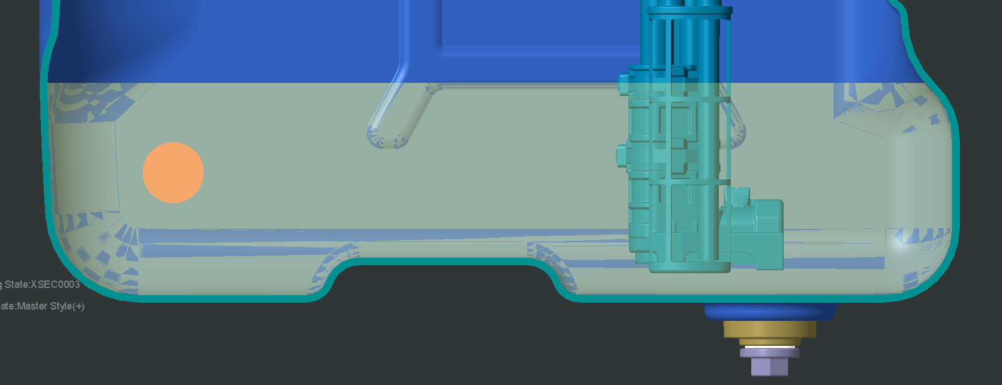
Technical parameter Verification:
S.No. | Parameter | Findings | Remarks
1 | Filter Clogging due to NOK urea | Ca, Na, Al, Si & PO4 Found as Impurity | MDEP 2D Filter is more sensitive to scaling due to Ca. Mg, Al, Na E494 Media is Less sensitive to Scaling but more sensitive to Dirt From Field Experience E494 Filter clogging is Compared vehicle.
2 | Filtration area Causing Filtration | Very Early Filter Clogging seems independent 0f Filtration area | Considering Field usage, the filtration area is not sufficient
3 | NOK Urea used in Field Filling Hygine |  | Actions to be Concluded.
4 | Tank cleanliness | Urea Rinsing in tank leading to crystal formation Presence of dust particles in Urea Tank at supplier’s end. | Improved cleaning processes like vacuum cleaning, de- ionized cleaning, pressurized air cleaning etc. implemented at BAPL & ROTOTECH(Refer attached PDF)
5 | Warning limit too low in urea tank |  | Warning limits increased from 10% to 15%.
Filter exposed to air

Slide 5
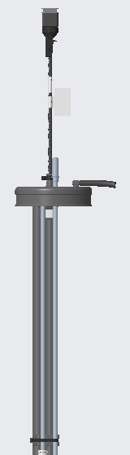
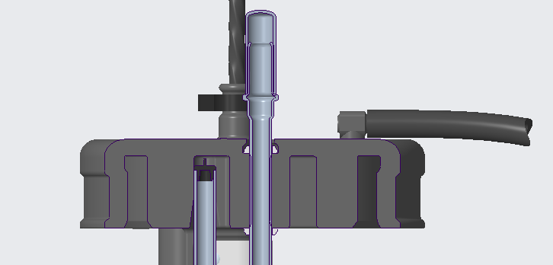
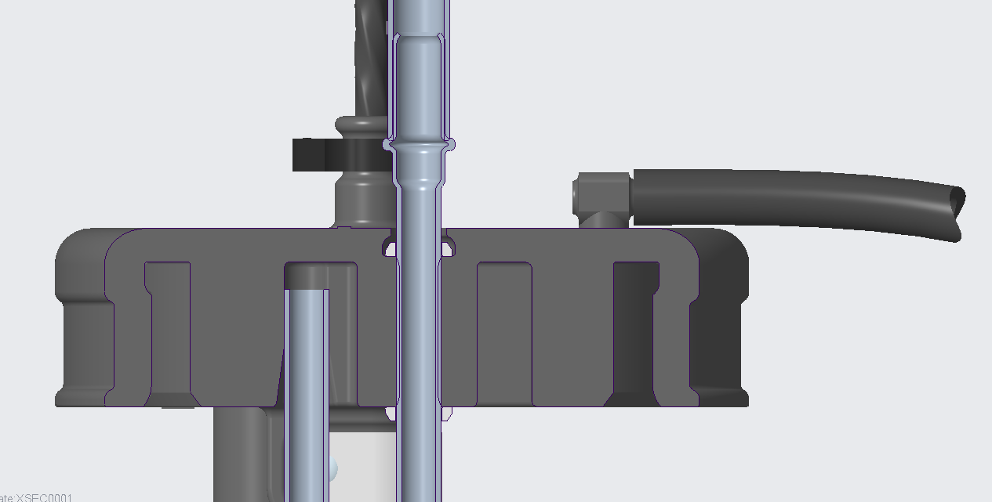
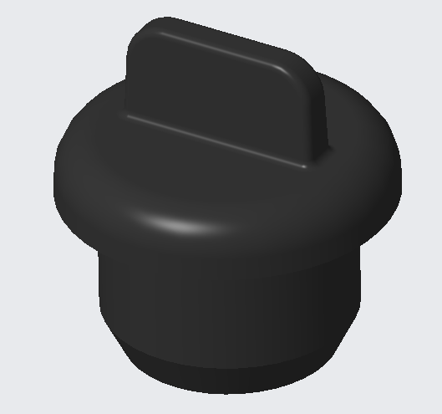
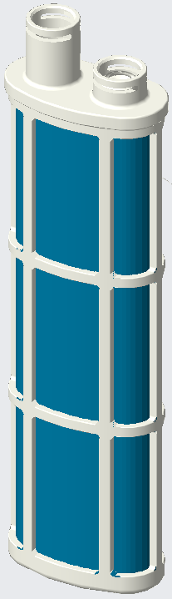
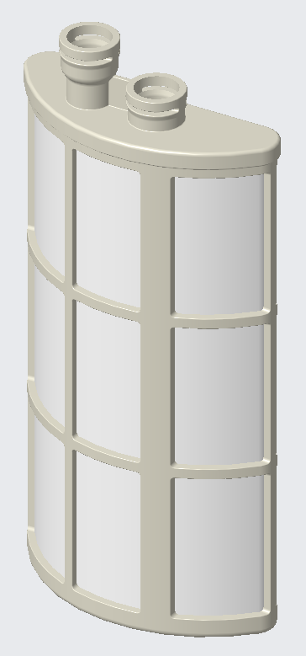
UQLS Comparison
Existing
New
Suction pipe
Vent Plug in air vent pipe of the filter
Air Vent pipe
VENT PLUG
(ID630277)
Open air vent pipe
3D Filter (ID627891) :
1. Filtration media : SEFAR ACCUFLOW 06-150-30
2. Filtration area = 18,600mm²
2D filter (ID381545) :
1. Filtration media : SEFAR NITEX 03-35-16
2. Filtration area = 10,000mm²

